Slide 1

KP-IT Board AI (ML/DL) Certification
Trainer: Fawad Bahadur
2

Slide 2


Computer Vision: From Basics to Expert Level
Advanced Computer Vision & Image Processing with Python
Dated: 28 June 2025
Instructor : Fawad Bahadur

Slide 3





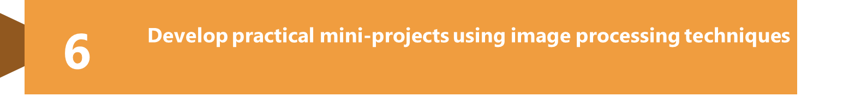
Training Objectives & Outcomes

Slide 4

Orientation & Prerequisites
✅ Linear algebra & matrix calculus refresher
✅ Probability, Bayes, & information theory
✅ Python/NumPy/Pandas & Git workflow
✅ Computational thinking: vectorization, broadcasting, complexity

Slide 5
Machine-Learning Curriculum Map
1. Supervised Learning Fundamentals 2. Model Evaluation & Selection 3. Feature Engineering & Representation 4. Unsupervised & Self-Supervised Learning
5. Deep Learning Stack
6. Probabilistic & Bayesian Machine Learning
7. Online, Streaming & Edge Learning
8. Responsible AI & Governance
9. MLOps & Production Systems
10. Recent Research Trends (2022-2025)

Slide 6

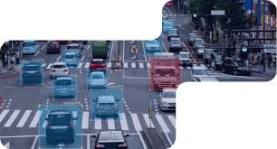
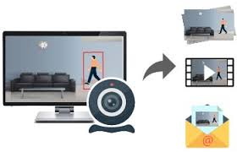
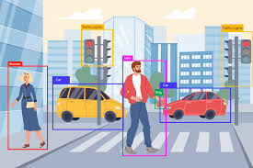
Core Features of OpenCV
Video Analysis
Read, write, and process videos frame-by-frame in real-time
Object Detection & Recognition
Face detection, motion tracking, and feature matching
Camera Integration
Access and process webcam/video stream feeds

Slide 7
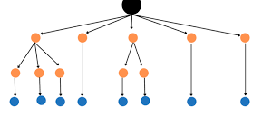
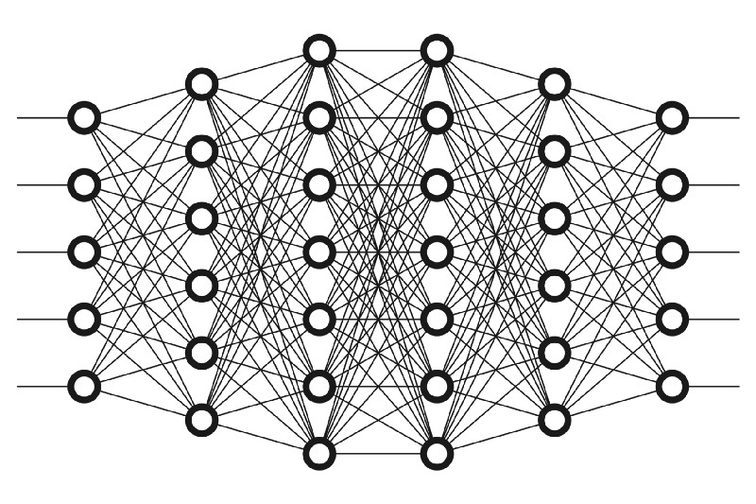

Conti…
Machine Learning Module
Includes built-in classifiers (SVM, KNN, Decision Trees)
Deep Learning Support
Run pre-trained models (TensorFlow, Caffe, PyTorch, ONNX)
Platform Independence
Works on Windows, macOS, Linux, Android, and iOS

Slide 8
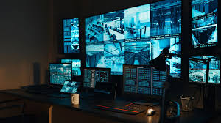
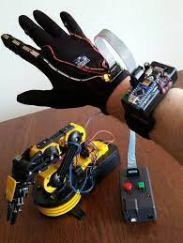
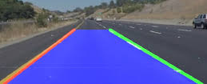
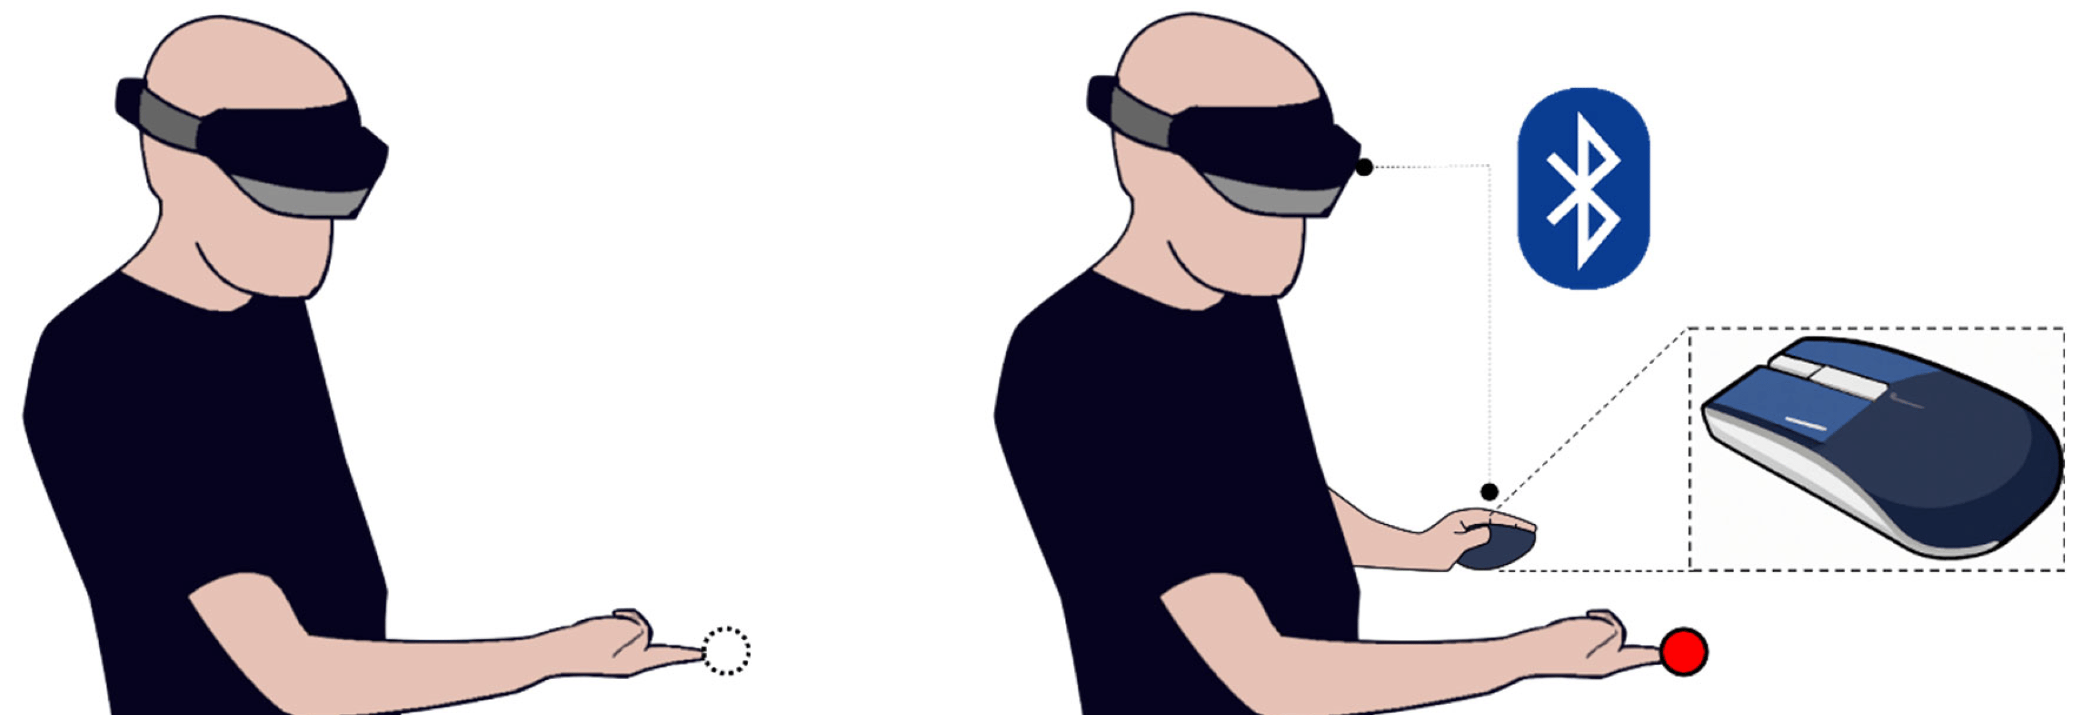
Applications of OpenCV
Face & Object Detection
Used in surveillance, biometrics, and camera apps
Autonomous Vehicles
Lane detection, object recognition, and navigation systems
Robotics
Vision-based navigation, gesture control, and automation
Augmented Reality (AR)
Real-time marker tracking and image overlay

Slide 9
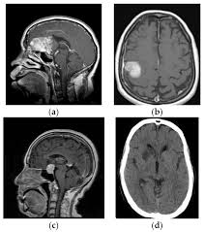
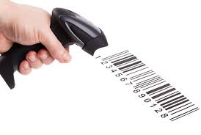

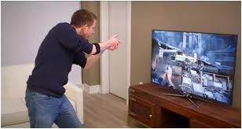
Conti…
Healthcare & Medical Imaging
Image enhancement, tumor detection, diagnostic tools
Industrial Automation
Quality inspection, motion analysis, barcode scanning
Gaming & Gesture Recognition
Interactive gaming using motion or facial input

Slide 10


Installing OpenCV
Method 1: Using pip (Recommended for most users)
Bash
!pip install opencv-python
Method 2: Using Anaconda
Bash
conda install -c conda-forge opencv

Slide 11
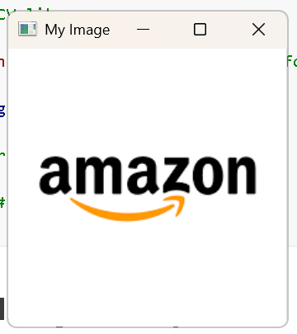
Reading and Displaying Images with OpenCV
Import OpenCV
Python
import cv2
2. Read an Image
Python
img = cv2.imread("image.jpg") # Reads image in BGR format
3. Display the Image
Python
cv2.imshow("My Image", img)
cv2.waitKey(0)
cv2.destroyAllWindows()
Notes
cv2.imread() can return None if the file path is incorrect
cv2.waitKey(0) waits for a key press
Always use cv2.destroyAllWindows() to close display windows

Slide 12
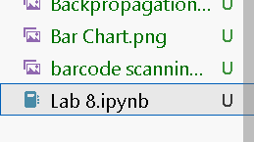
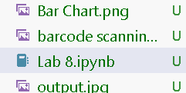
Writing and Saving Images in OpenCV
Saving Images to Disk
1. Import and Read Image
Python
import cv2img = cv2.imread("input.jpg")
2. Save Image
Python
cv2.imwrite("output.jpg", img)
Before
After
Notes
Format depends on file extension: .jpg, .png, .bmp, etc.
Ensure destination folder exists or use full path
Returns True if saved successfully, otherwise False

Slide 13

Working with Video in OpenCV
1. Open Video Source
Python
import cv2cap = cv2.VideoCapture(0)
# 0 for webcam, or path to video file
2. Read & Display Frames
Python
while True:
ret, frame = cap.read()
if not ret:
break
cv2.imshow("Video", frame)
if cv2.waitKey(1) & 0xFF == ord('q’):
break
3. Release Resources
pythoncap.release()
cv2.destroyAllWindows()
Notes
Use 0 for default webcam, 1 or file path for others
cv2.waitKey(1) controls frame speed
Press ‘q’ to exit video window

Slide 14
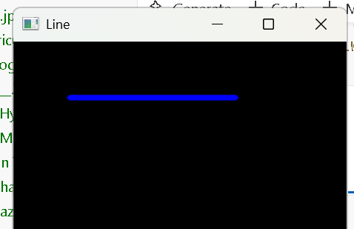
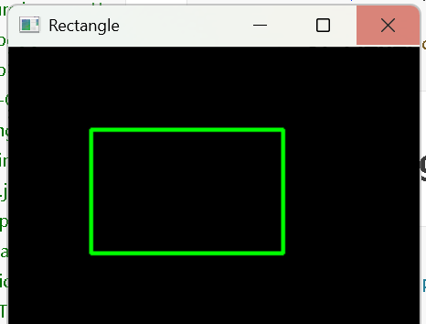
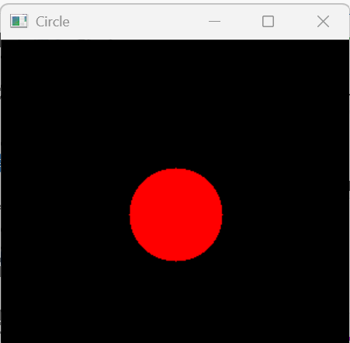
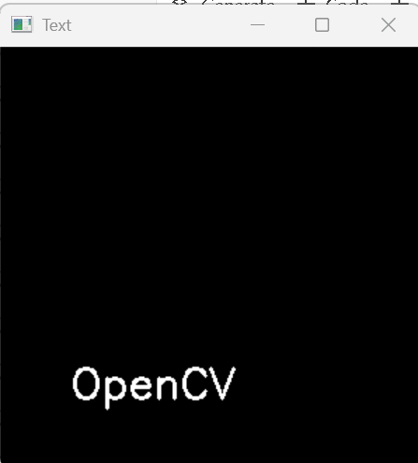
Drawing Shapes and Text on Images
Line
Python
cv2.line(img, (50, 50), (200, 50), (255, 0, 0), 3)
2. Rectangle
Python
cv2.rectangle(img, (60, 60), (200, 150), (0, 255, 0), 2)
3. Circle
Python
cv2.circle(img, (150, 150), 40, (0, 0, 255), -1) # -1 = filled
4. Put Text
Python
cv2.putText(img, "OpenCV", (50, 250), cv2.FONT_HERSHEY_SIMPLEX, 1, (255, 255, 255), 2)
Notes
Coordinates are in (x, y) format
Color is in BGR (Blue, Green, Red)
Thickness: use -1 for filled shapes

Slide 15
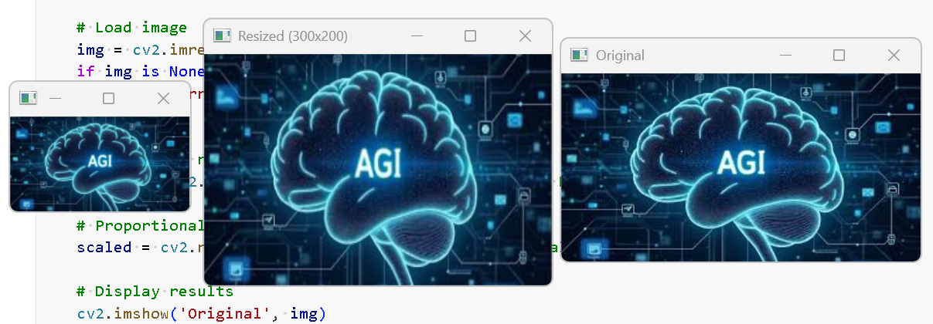
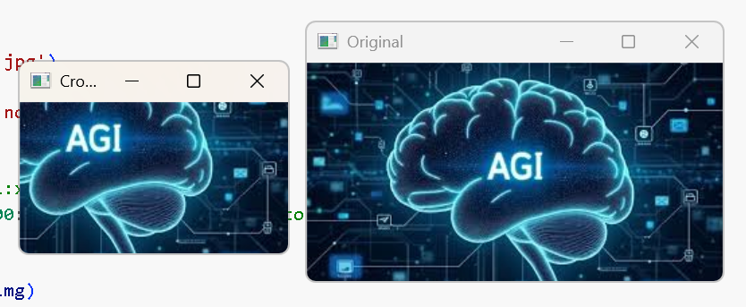
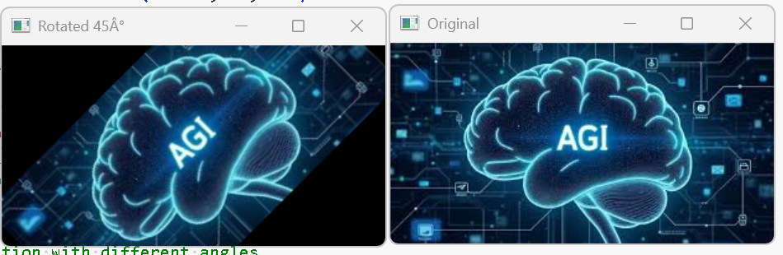
Image Resizing, Cropping, and Rotation
Resizing
Python
resized = cv2.resize(img, (300, 200)) # Width x Height
Maintain aspect ratio using scaling:
Python
resized = cv2.resize(img, None, fx=0.5, fy=0.5)
2. Cropping
Python
cropped = img[50:200, 100:300] # img[y1:y2, x1:x2]
3. Rotation
Python
(h, w) = img.shape[:2]
center = (w // 2, h // 2)
M = cv2.getRotationMatrix2D(center, 45, 1.0)
# 45° rotationrotated = cv2.warpAffine(img, M, (w, h))
Notes
Resizing can distort images if aspect ratio not maintained
Cropping is simply slicing the NumPy array
Rotation uses affine transform centered on the image

Slide 16
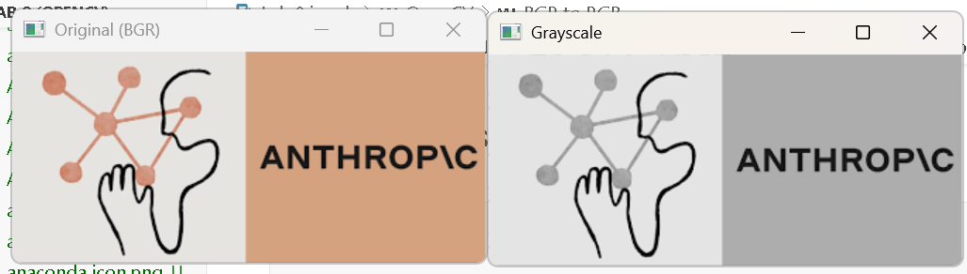
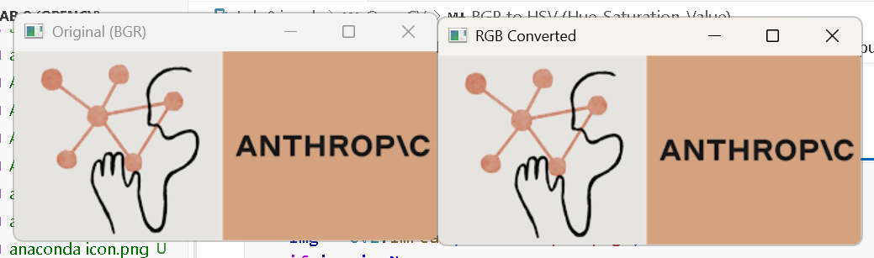
Color Spaces and Conversions
What is a Color Space?
A way to represent colors. Different color spaces are used for different computer vision tasks.
Common Color Conversions:
BGR to Grayscale
gray = cv2.cvtColor(img, cv2.COLOR_BGR2GRAY)
2. BGR to RGB
rgb = cv2.cvtColor(img, cv2.COLOR_BGR2RGB)
3. BGR to HSV
hsv = cv2.cvtColor(img, cv2.COLOR_BGR2HSV)
4. BGR to LAB
lab = cv2.cvtColor(img, cv2.COLOR_BGR2LAB)
Use Cases
Grayscale: Simplifies processing
HSV: Better for color filtering
RGB: For displaying with matplotlib
LAB: For lighting-independent processing

Slide 17
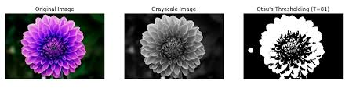
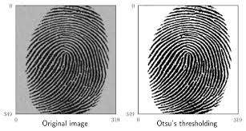
Image Thresholding Techniques
What is Thresholding?
A method to segment an image by converting it to binary form (black & white) based on pixel intensity.
Simple Thresholding
_, thresh = cv2.threshold(gray, 127, 255, cv2.THRESH_BINARY)
Other Modes:
-cv2.THRESH_BINARY_INV
cv2.THRESH_TRUNC
cv2.THRESH_TOZERO
2. Adaptive Thresholding
adaptive = cv2.adaptiveThreshold(
gray, 255,
cv2.ADAPTIVE_THRESH_MEAN_C,
cv2.THRESH_BINARY, 11, 2)
3. Otsu's Binarizatio
_, otsu = cv2.threshold(gray, 0, 255, cv2.THRESH_BINARY + cv2.THRESH_OTSU)
Use Cases
Object detection
Text extraction
Background removal

Slide 18
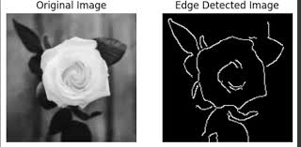
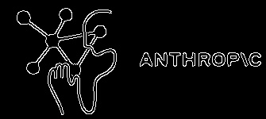
Edge Detection Techniques
What is Edge Detection?
Edge detection highlights the boundaries and outlines within an image — essential for object detection, shape analysis, etc.
Use Cases
Contour detection
Preprocessing for segmentation
Shape/feature recognition
Canny Edge Detection
Python
edges = cv2.Canny(img, 100, 200)
Low threshold: 100
High threshold: 200
Most widely used and accurate edge detection

Slide 19
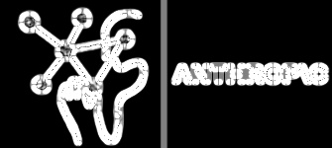
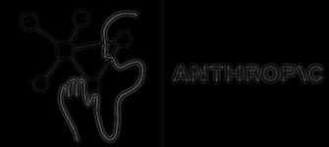
Conti…
2. Sobel Operator
Python
sobelx = cv2.Sobel(gray, cv2.CV_64F, 1, 0, ksize=5)
sobely = cv2.Sobel(gray, cv2.CV_64F, 0, 1, ksize=5)
Detects edges in horizontal and vertical directions
3. Laplacian Operator
Python
laplacian = cv2.Laplacian(gray, cv2.CV_64F)
- Captures all-direction edges

Slide 20
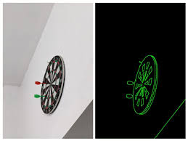
Contour Detection and Drawing
What are Contours?
Contours are continuous curves joining all the points along a boundary with the same color or intensity — useful for shape analysis and object detection.
Use Cases
Object counting
Shape recognition
Measuring object area/perimeter
Drawing Contours
Python
cv2.drawContours(img, contours, -1, (0, 255, 0), 2)
Draws all contours in green with line thickness of 2.

Slide 21
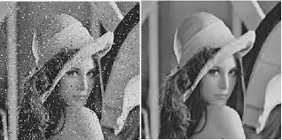
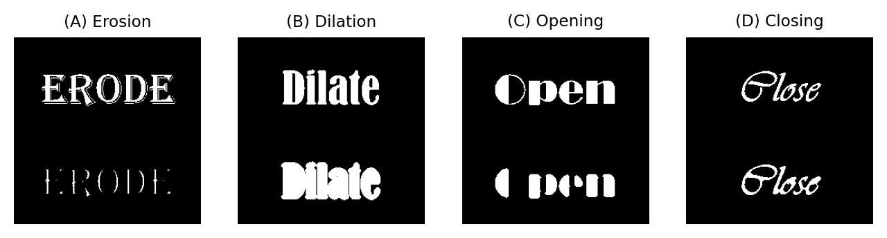
Morphological Transformations
What are Morphological Operations?
Morphological transformations apply a structuring element to process images based on shapes. Common in noise removal and shape manipulation.
Applications
Noise cleaning
Filling gaps
Object separation

Slide 22
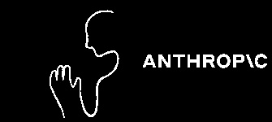


Morphological Transformations
Erosion
Python
erosion = cv2.erode(img, kernel, iterations=1)
Removes boundaries of objects
Useful for removing small white noises
2. Dilation
Python
dilation = cv2.dilate(img, kernel, iterations=1)
Adds pixels to object boundaries
Enhances object size

Slide 23

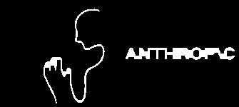
Morphological Transformations
3. Opening (Erosion followed by Dilation)
Python
opening = cv2.morphologyEx(img, cv2.MORPH_OPEN, kernel)
Removes noise while preserving shape
4. Closing (Dilation followed by Erosion)
Python
closing = cv2.morphologyEx(img, cv2.MORPH_CLOSE, kernel)
Closes small holes inside objects

Slide 24
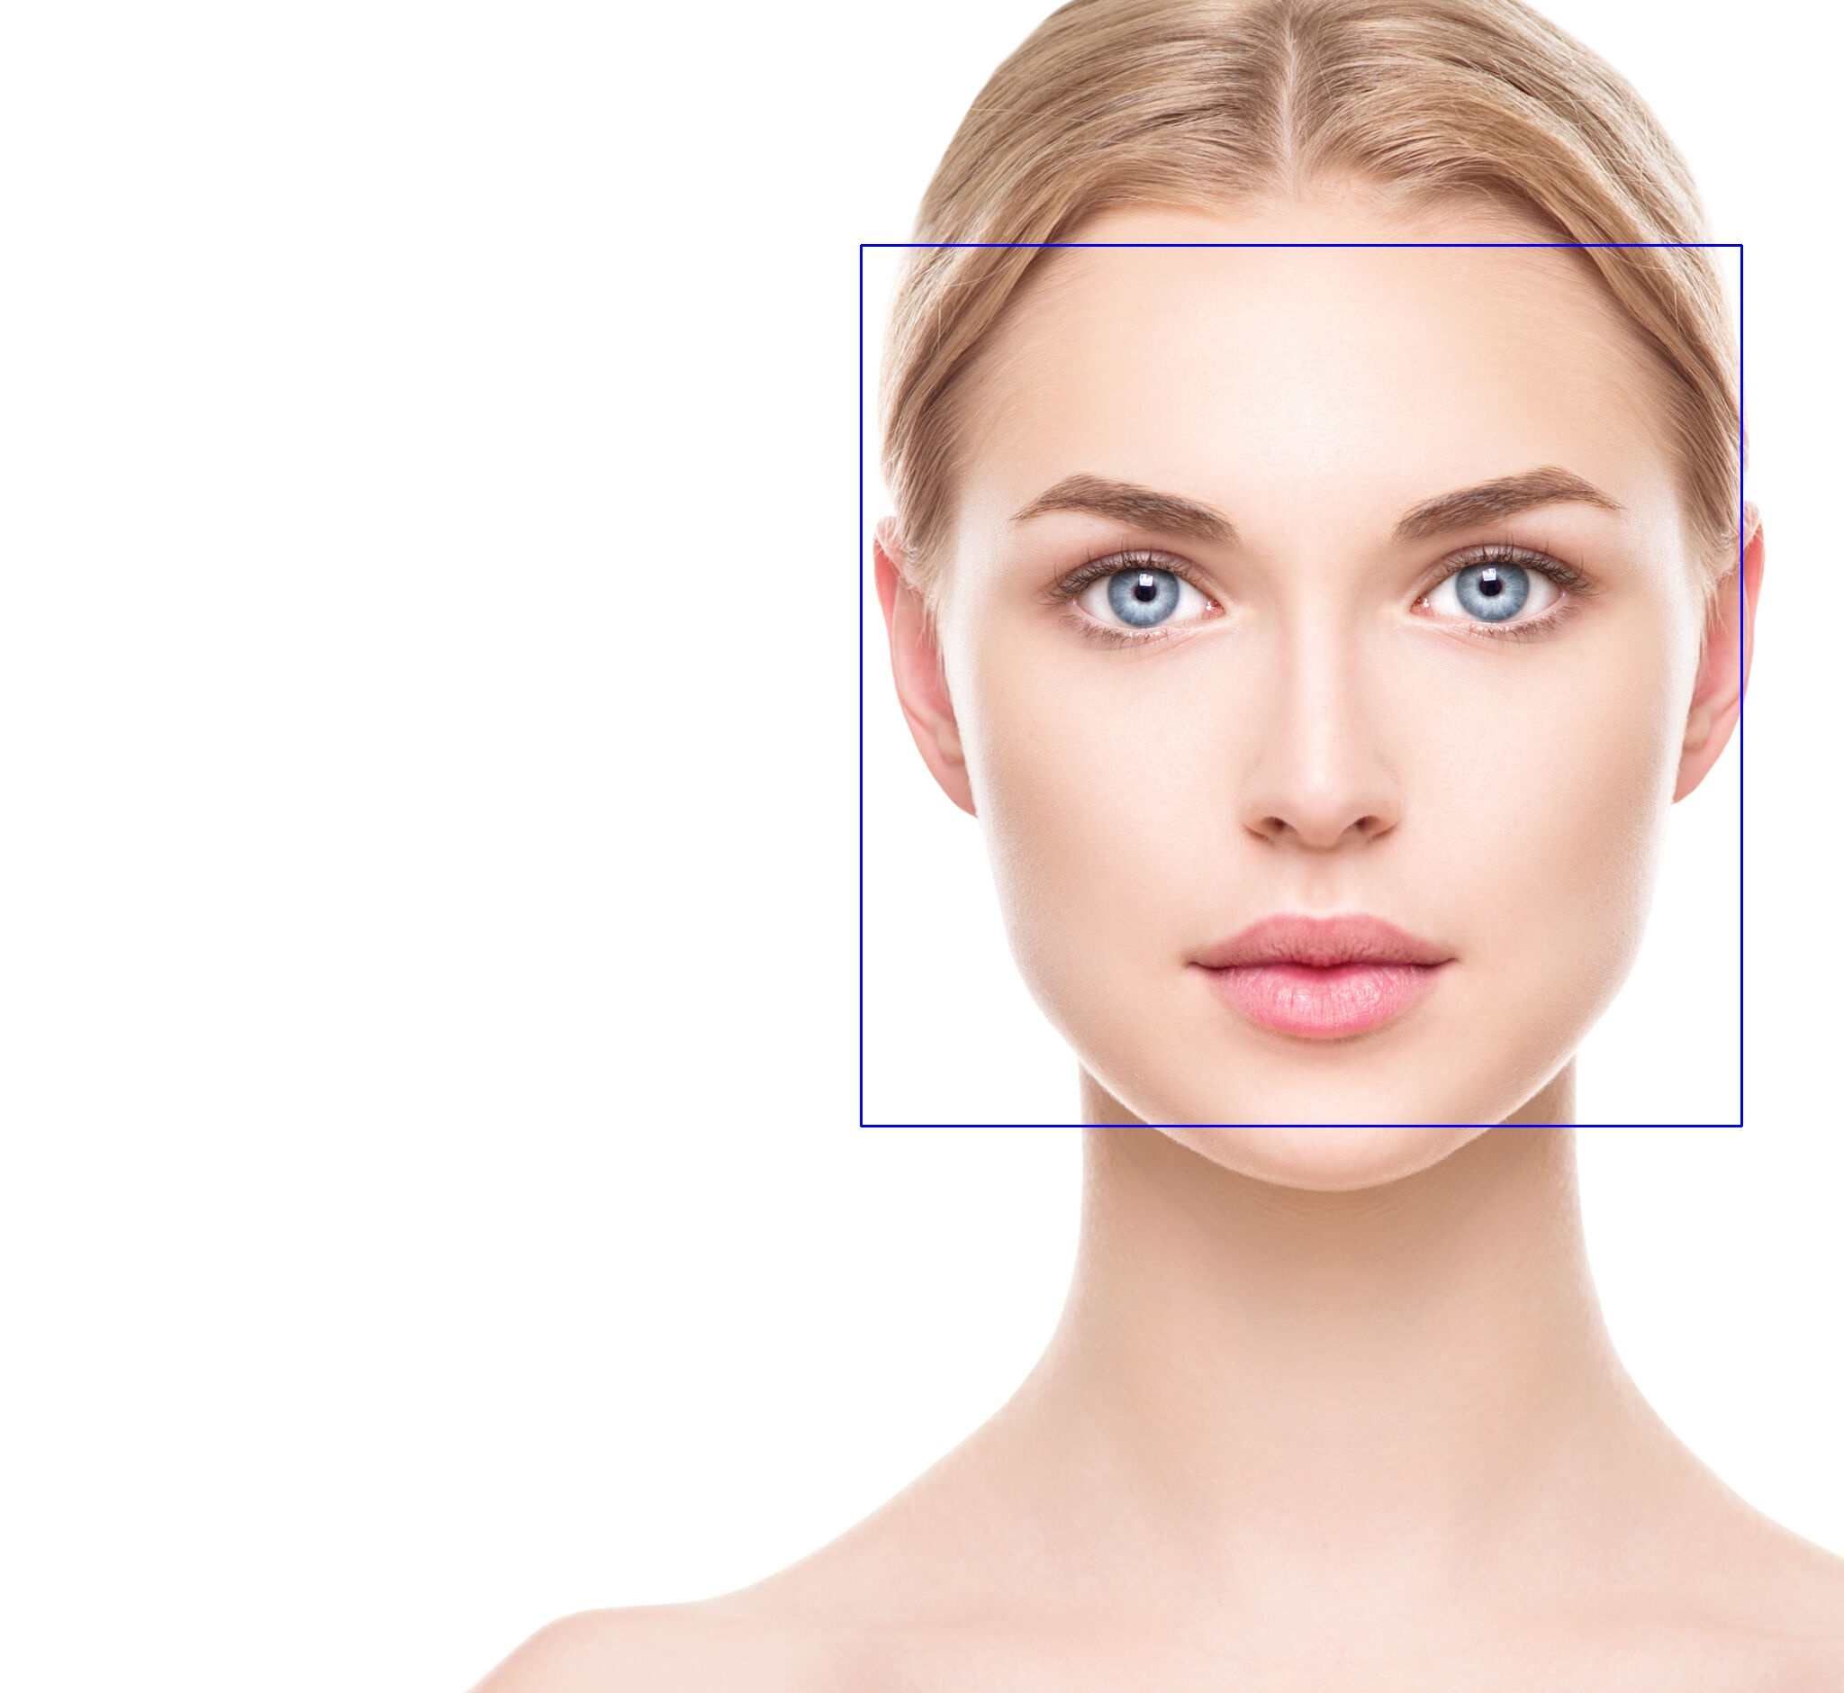
Face Detection with Haar Cascades
What are Haar Cascades?
A machine learning–based approach used for object detection, especially faces, using features like edges, lines, and rectangles.
How It Works:
Haar features extracted from the image
Trained classifiers detect patterns
Cascade classifier improves detection speed

Slide 25
Conti…
Steps in OpenCV:
Python
face_cascade = cv2.CascadeClassifier('haarcascade_frontalface_default.xml’)
gray = cv2.cvtColor(img, cv2.COLOR_BGR2GRAY)
faces = face_cascade.detectMultiScale(gray, 1.3, 5)
for (x, y, w, h) in faces:
cv2.rectangle(img, (x, y), (x + w, y + h), (255, 0, 0), 2)
Notes
Use grayscale images for detection
Parameters: scaleFactor, minNeighbors
Pre-trained XML models available in OpenCV

Slide 26
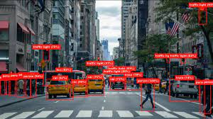
Object Detection with Pre-trained Models
What is Object Detection?
Object detection involves locating and classifying multiple objects in an image or video stream.
Components of Object Detection
Classification: What is in the image?
Localization: Where is the object?
Detection: What & where together!
Popular Pre-trained Models in OpenCV:
MobileNet-SSD
YOLO (You Only Look Once)
Faster R-CNN
Use Cases
Real-time surveillance
Smart cameras
Traffic monitoring

Slide 27
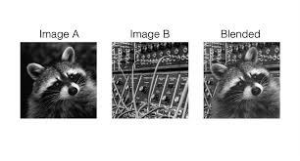
Image Blending Techniques
What is Image Blending?
Combining two images to produce a visually smooth transition or overlay effect.
Types of Blending
Simple Addition
Weighted Blending
Mask-Based Blending
Use Cases
Overlaying logos
Transition effects
Panorama stitching
Exposure fusion

Slide 28
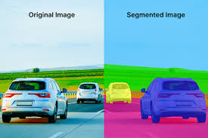
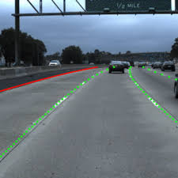
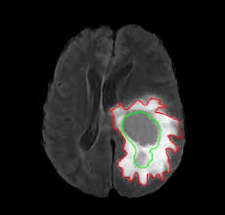
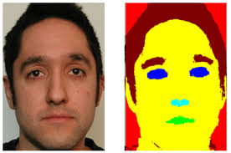
Image Segmentation in Computer Vision
What is Image Segmentation?
Image segmentation is the process of dividing an image into meaningful regions or segments for easier analysis.
Purpose
Isolate objects from background
Aid in object detection & recognition
Used in medical imaging, self-driving cars, etc.
Use Cases
Medical image analysis
Face & object recognition
Lane detection in autonomous driving

Slide 29


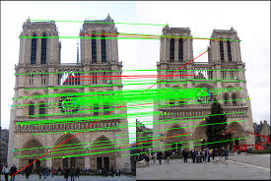
Feature Detection in Images
What is Feature Detection?
Feature detection identifies key points or areas of interest in an image that are unique and can be tracked or matched across images.
Popular Feature Detection Algorithms
Harris Corner Detector
Shi-Tomasi (Good Features to Track)
SIFT (Scale-Invariant Feature Transform)
ORB (Oriented FAST and Rotated BRIEF)
Use Cases
Image stitching
Object recognition
Motion tracking
Augmented reality

Slide 30
THANK YOU
Instructor : Fawad Bahadur

